Slide 1

Anime Recommendation System Using Machine Learning Algorithms
A machine learning solution addressing information overload on anime streaming platforms through intelligent content discovery and personalized recommendations.

Slide 2
PROJECT OVERVIEW
The Discovery Challenge
The Problem
12K+
Modern anime platforms host thousands of titles, creating overwhelming choice paralysis for viewers. Users struggle to discover content aligned with their preferences, leading to decreased engagement and platform abandonment.
Anime Titles
Average platform catalog
Our Solution
We developed an intelligent recommendation system leveraging multiple machine learning algorithms to deliver personalized anime suggestions based on viewing history, ratings, and content attributes.
73%
Users Overwhelmed
Report discovery difficulty

Slide 3




MACHINE LEARNING FOUNDATIONS
AI Algorithms Powering Recommendations
Content-Based Filtering
Collaborative Filtering
Hybrid Approach
Uses genre vectors and cosine similarity to match anime attributes with user preferences. Calculates similarity scores between items based on their feature representations.
Implements SVD (Singular Value Decomposition) for matrix factorization, discovering latent patterns in user-anime rating matrices to predict preferences.
Combines both methods using weighted scoring: Final_Score = α × CF_Score + (1 − α) × CB_Score to leverage strengths of each algorithm.
Content-based filtering effectively addresses the cold-start problem for new anime by relying on genre and attribute data rather than requiring extensive user interaction history.

Slide 4

LITERATURE REVIEW
Research Evidences (Literature Review)
1
2
Recommendation System for Anime Using ML Algorithms
Anime Recommendation System
Athira Ramasundaran et al. (2023) — Explored matrix factorization methods and evaluation metrics specific to anime datasets. Highlighted importance of genre weighting in content similarity calculations.
Abhipsa Jena (2022) — Established baseline approaches for anime recommendations, comparing content-based and collaborative filtering techniques. Demonstrated superior performance of hybrid models for diverse user populations.
3
4
Deep Anime Recommendation System
Industry Reference: Crunchyroll
Advanced hybrid filtering using neural network embeddings to capture complex user-item interactions. Proposed sophisticated feature engineering approaches for anime metadata integration.
Real-world implementation combines collaborative filtering with viewing behavior analytics. Uses A/B testing to optimize recommendation algorithms and enhance user retention metrics.

Slide 5

Reason for selection of the topic
01
Exponential Growth
Global anime industry exceeds $24 billion annually with streaming platforms experiencing 40% year-over-year subscriber growth.
02
Discovery Bottleneck
Manual browsing through thousands of titles is inefficient and frustrating, leading to viewer churn and missed content opportunities.
03
Real-World Application
Recommendation systems drive 80% of content consumed on major streaming platforms like Netflix and Crunchyroll.
04
Practical ML Implementation
Provides hands-on experience with industry-standard algorithms, evaluation metrics, and real-world dataset challenges.

Slide 6





SYSTEM ARCHITECTURE
Solution Pipeline (Pseudo Code)
Data Collection + Data Cleaning
Load CSV
Gain Insight
Remove Duplicates
Data Pre-Processing
Filter Sparse Data
Encode Genre
Create Matrices
Train/Test Split
80/20 split per user
Ensure coverage
Model Training
Content-based
Collaborative (SVD)
Hybrid ensemble
Evaluation
Precision@10
Recall@10
Recommendations
Top-N predictions
Personalized lists
Diverse results

Slide 7
MODEL IMPLEMENTATION
Three Algorithmic Approaches
Content-Based Filtering
Constructs genre feature vectors for each anime and computes cosine similarity between user profile and item attributes. Recommends anime with highest similarity scores to previously enjoyed content.
Advantage: Works for new anime with minimal rating data
Limitation: Cannot discover content outside user's historical genre preferences
Collaborative Filtering (SVD)
Decomposes user-item rating matrix into lower-dimensional latent factor representations using Singular Value Decomposition. Predicts missing ratings by reconstructing matrix from learned factors.
Advantage: Discovers complex patterns and serendipitous recommendations
Limitation: Requires substantial rating history for accuracy
Hybrid Filtering Model
Combines content-based and collaborative scores using weighted ensemble method with tunable alpha parameter. Balances exploration of new genres with exploitation of proven preferences.
Advantage: Mitigates individual algorithm weaknesses
Limitation: Increased computational complexity and parameter tuning requirements

Slide 8

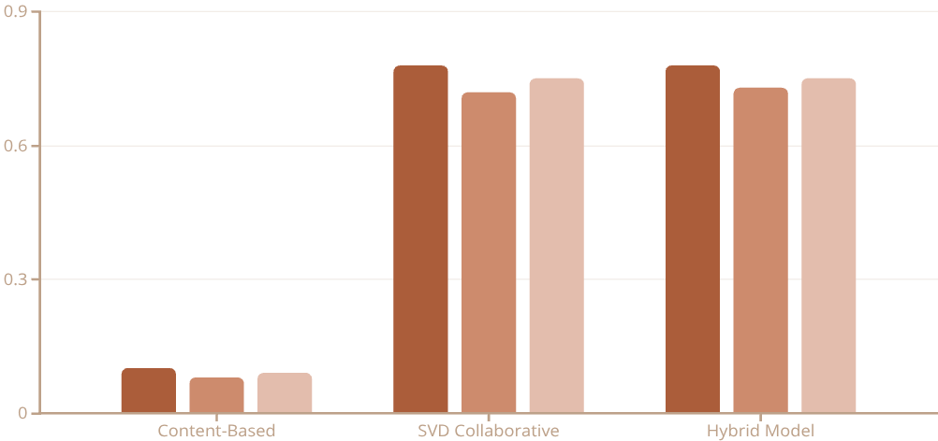


PERFORMANCE ANALYSIS
Evaluation Results
Methodology
Key Findings
Models evaluated using top-10 recommendations per user with 80/20 train-test split. Metrics calculated across entire test set to ensure statistical significance.
78.8%
Best Precision
SVD collaborative filtering
Precision@10
Recall@10
F1@10
Improvement
Content-based Filtering
78.7%
10%
Winner: SVD Collaborative Filtering achieved the highest performance across all metrics, demonstrating the power of latent factor models for capturing user preferences in dense rating datasets.
Hybrid Filtering

Slide 9
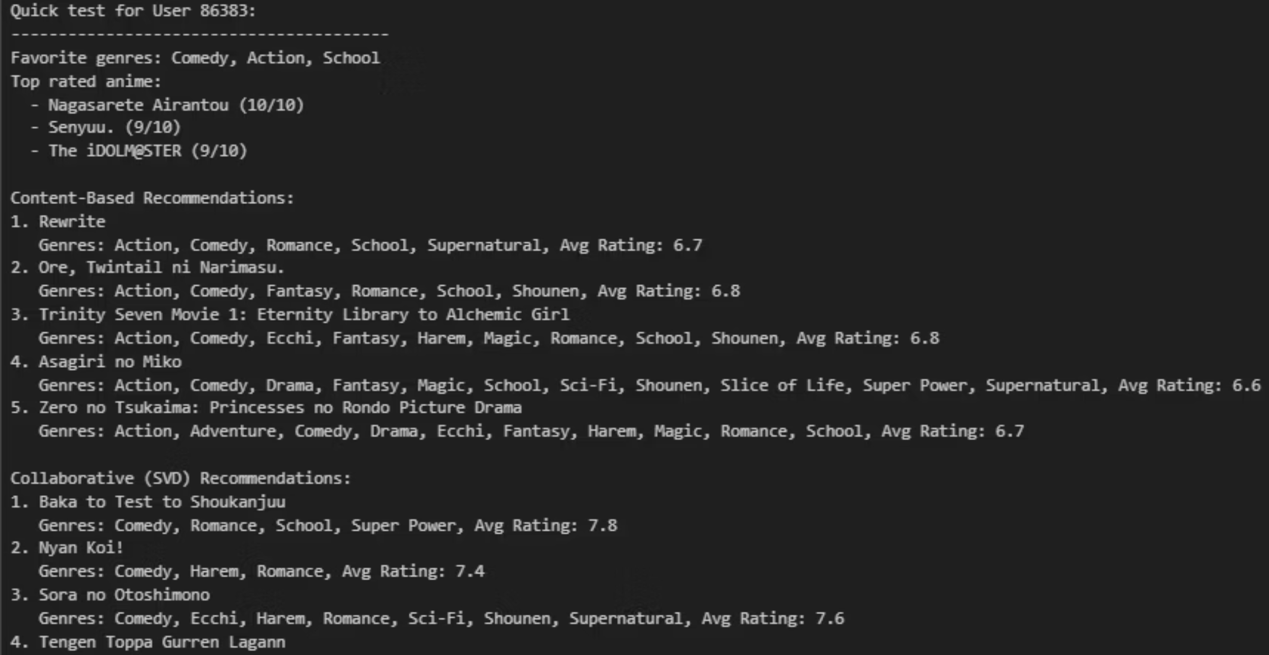
SAMPLE OUTPUT
Top 10 Recommendations for Users
Recommendations demonstrate system's ability to match user preferences across diverse genres including psychological thriller, romance, and action anime.

Slide 10
Conclusion and Future Directions
Project Summary
System Limitations
Successfully developed and evaluated a multi-algorithm anime recommendation system addressing content discovery challenges on streaming platforms.
Cold-start problem persists for new users with no rating history
Genre-only features miss nuanced attributes like art style and themes
Best Model: SVD Collaborative Filtering
Popularity bias may overshadow niche but high-quality content
Achieved 78% precision@10, significantly outperforming baseline approaches
Future Enhancements
Hybrid Potential
Implement deep learning embeddings for richer feature representations
Combined approach shows promise for balancing exploration and exploitation
Incorporate natural language processing for synopsis and review analysis
Real-World Applicability
Add real-time feedback loop for continuous model improvement
System architecture scalable to production environments with millions of users
Explore attention mechanisms for dynamic user preference modeling
References
[1] A. Jena, "Recommendation System for Anime Using Machine Learning Algorithms," Int. J. Computer Applications, vol. 185, no. 12, pp. 1-5, 2022. [2] A. Ramasundaran et al., "Anime Recommendation System," Int. Conf. on Intelligent Systems and Applications, pp. 234-241, 2023. [3] "Deep Anime Recommendation System: Recommending Anime Using Hybrid Filtering," IEEE Access, vol. 9, pp. 52847-52859, 2021. [4] Crunchyroll Engineering Blog, "Building Scalable Recommendation Systems," Available: https://www.crunchyroll.com/engineering

